Slide 1

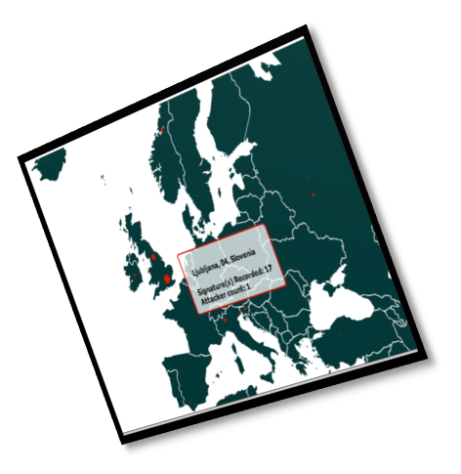
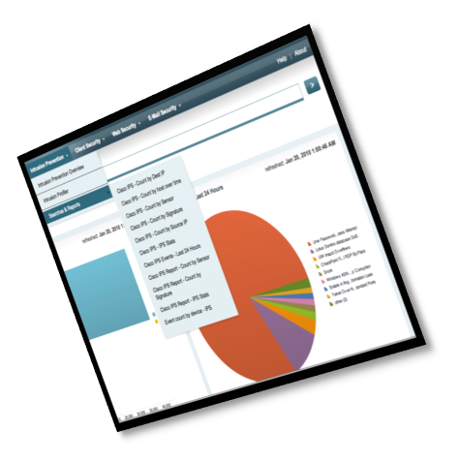
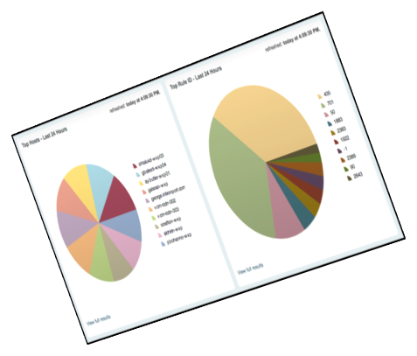
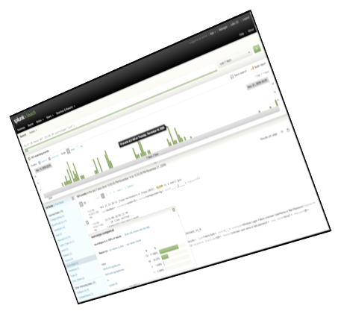



Overview
Architecture
© Copyright 2011 – Company Confidential Visibility when you need IT most.

Slide 2

What does Splunk collect?
Machine Generated Data, not Human Generated Data
Machine Data contains categorical record of all activity and behavior – customer behavior, user transactions, machine behavior
2

Slide 3
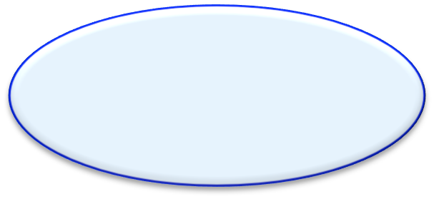

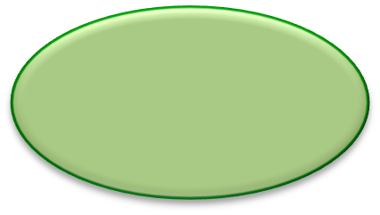
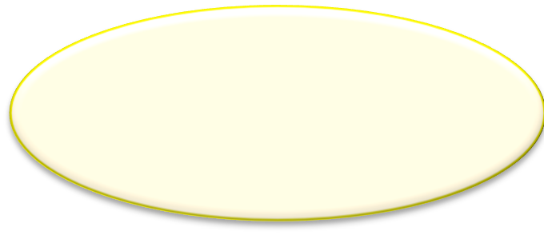
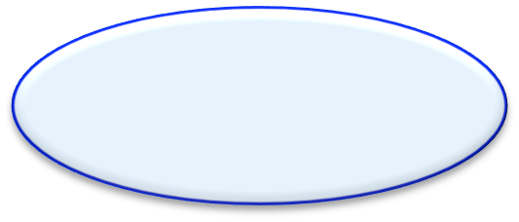
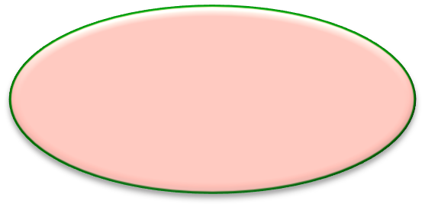
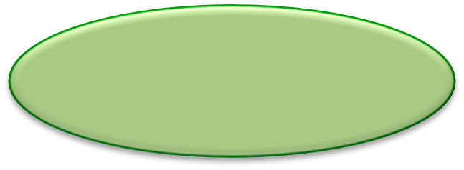
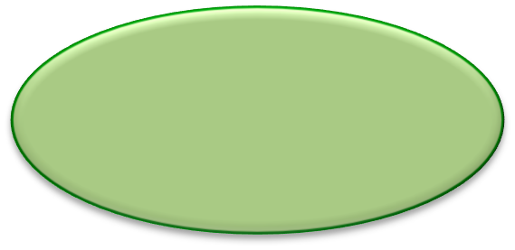


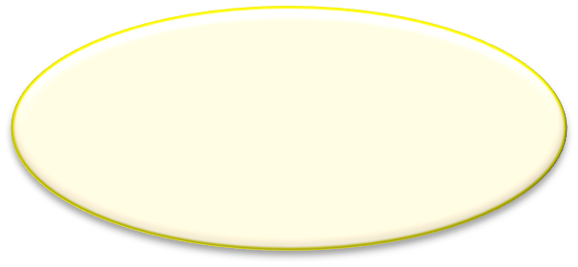
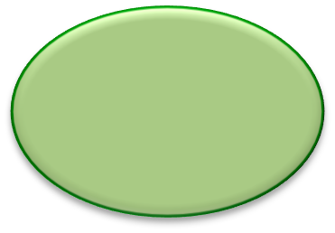
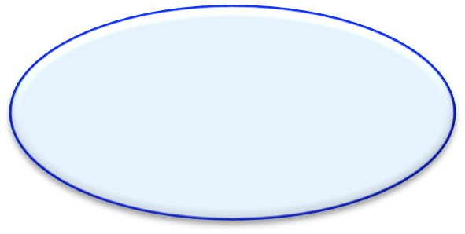
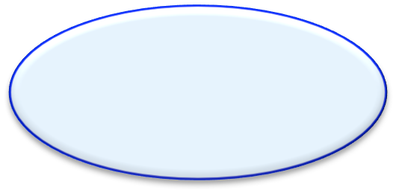
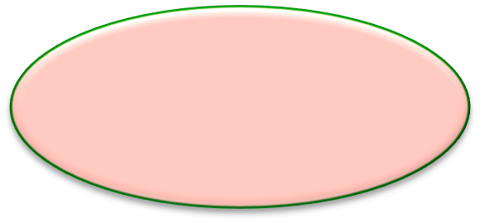
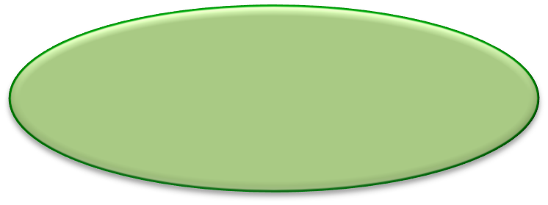
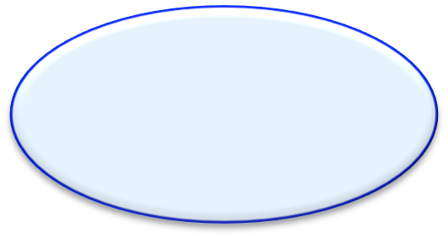



What does Splunk do?
Scripts
Vulnerability Data
Database Logs
Server Metrics
Router
Host Conﬁg
Card Key
Virtual Logs
Email Logs
Host IDS
RAS VPN
Custom Applications
Patch Mgmt
Server Logs
Physical Security
Windows registries
DNS Logs
Application Logs
3

Slide 4











What does Splunk Provide?
A common interface for all IT Data
search alert report
That provides Operational Intelligence
share
4

Slide 5

The Big Data Problem
What is Big Data?
“ …When the size of the data itself becomes part of the problem
Mike Loukides
O’Reilly Radar
“

Slide 6

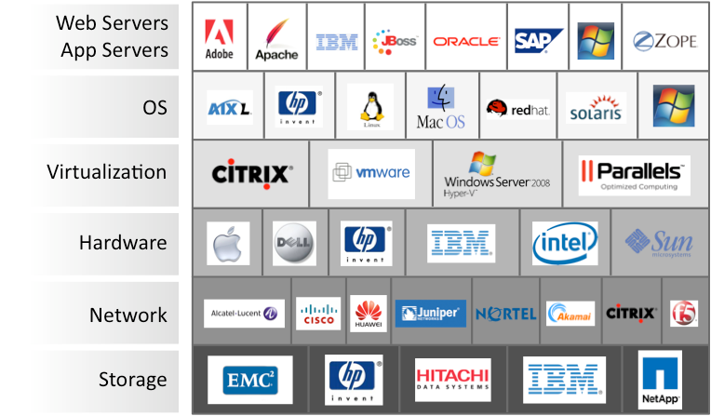


Machine data has its own “OSI model”
Complexity has increased logarithmically with the addition of each of these layers to the IT architecture.

Slide 7










Point Solutions are Common – lots of consoles
groan
Problem is exasperated since these stovepipe tools do not provide the ability to correlate events between them.

Slide 8

Point Solutions are Common – lots of consoles
Point solution tools:
No end to end situational Awareness across technologies
High cost of ownership
Slower resolution / Incident Response
groan
Problem is exasperated since these stovepipe tools do not provide the ability to correlate events between them.

Slide 9
What is needed is a single method to access IT information. . .
Phew

Slide 10

Across the entire IT Architecture
Ah-­‐Ha!

Slide 11


Across the entire IT Architecture
Correlation of disparate data in a single tool across all technologies:
Quicker root cause analysis
Increases situational awareness
Lowers business risk
Ah-­‐Ha!

Slide 12

See all IT and make IT useful
Finding your faults, just like Mom
Because ninjas are too busy
All batbelt no tights
Needle. Haystack. Found
It’s like grep on steroids
Only cavemen use event viewer
Take the SH out of IT
Log management at the speed of thought

Slide 13

What can you do?
Over 2,900 enterprise customers use Splunk to gain better insight and visibility from their machine data. Why?

Slide 14


Index all data without parsers or connectors
Customer Facing Data
Click-­‐stream data
Shopping cart data
Online transaction data
Outside the Datacenter
Manufacturing, logistics…
CDRs & IPDRs
Power consumption
RFID data
GPS data
Logfiles
Configs
Messages
Traps Alerts
Metrics
Scripts
Changes
Tickets
Virtualization & Cloud
Hypervisor
Guest OS, Apps
Cloud
Windows
Registry
Event logs
File system
sysinternals
Linux/Unix
Configurations
syslog
File system
ps, iostat, top
Applications
Web logs
Log4J, JMS, JMX
.NET events
Code and scripts
Databases
Configurations
Audit/query logs
Tables
Schemas
Networking
Configurations
syslog
SNMP
netflow

Slide 15


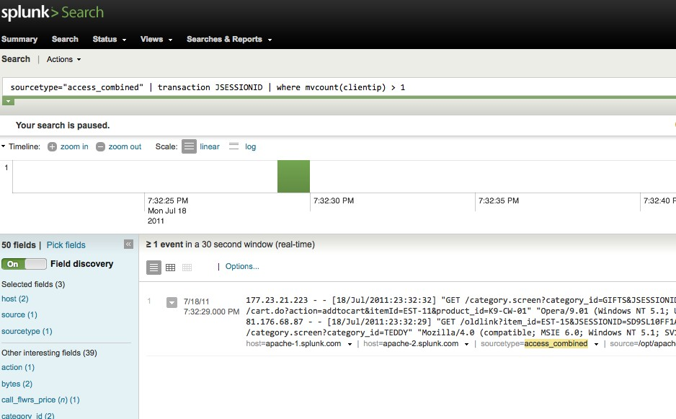
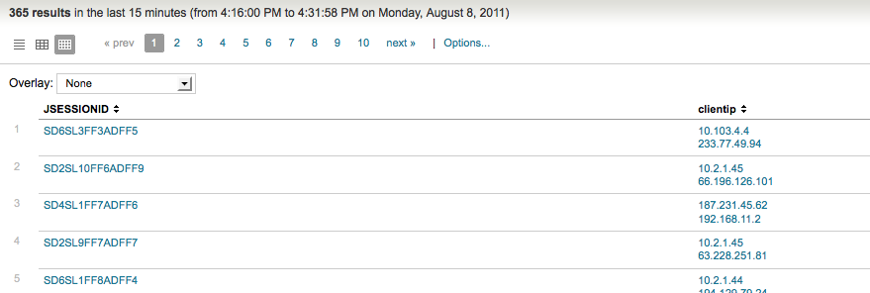
Search using a powerful search language
sourcetype="access_combined" | transaction JSESSIONID | where mvcount(clientip) > 1

Slide 16
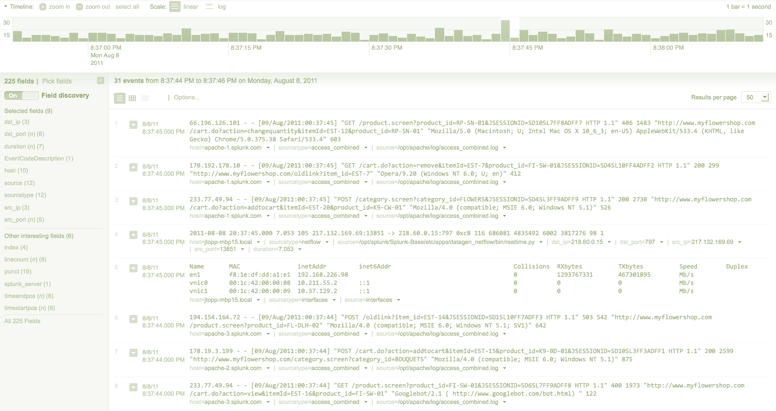





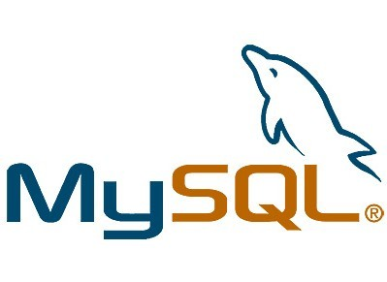




Automatic Chronology
20:23:49 – 20:28:16 Firewall events
20:28:16 Events detected moving across network from SQL server to other nodes
20:24:10 Reboot in Sever Logs / Odd Audit Events
20:23:54 Web Service Unavailable 20:23:50 CPU Spike on OS of SQL Server
20:23:49 Medium priority IDS events to SQL Server
© Copyright 2011 – Company Confidential
16
Visibility when you need IT most.

Slide 17

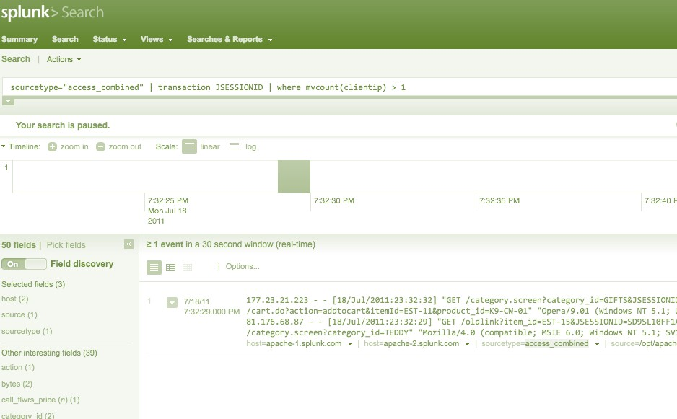


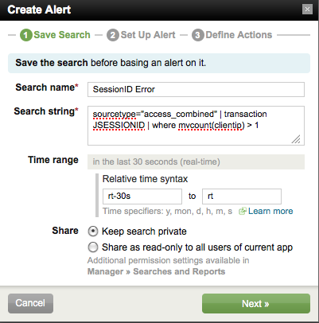
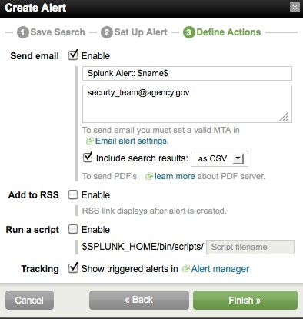

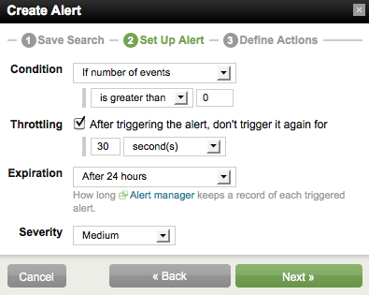
Alert in Real Time
Define the Alert
Alert Options
Who gets Alerted

Slide 18

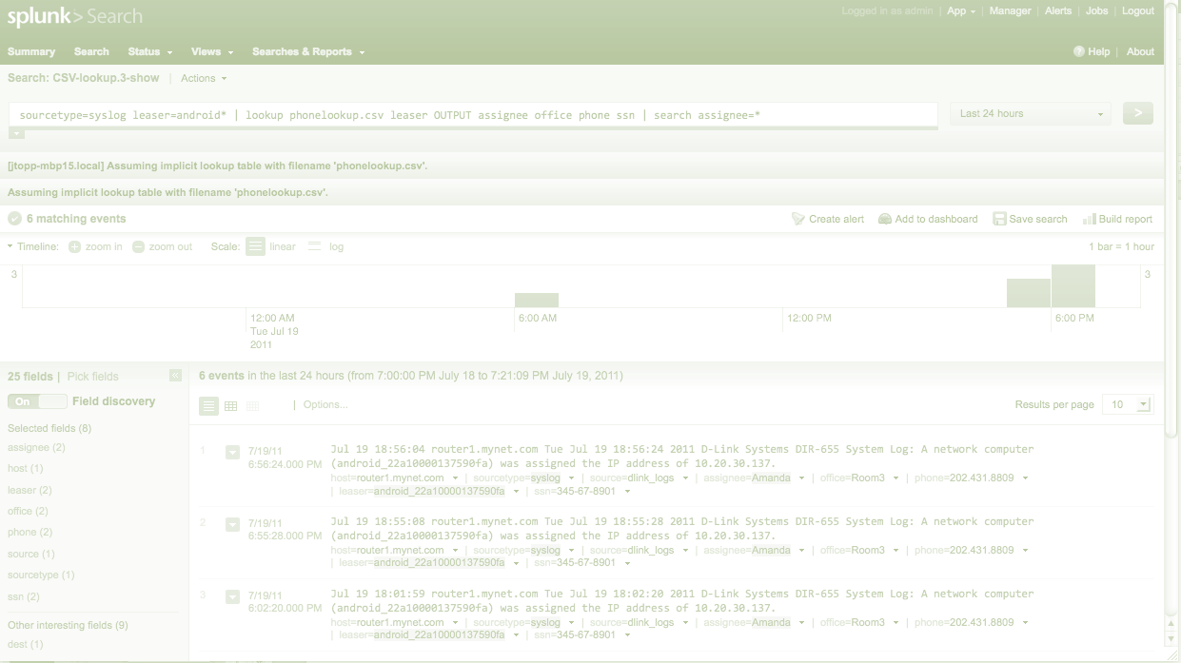

























Enrich data from external sources
LDAP, AD
Watch
Lists
CMDB
CRM/ERP
Better Understanding

Slide 19

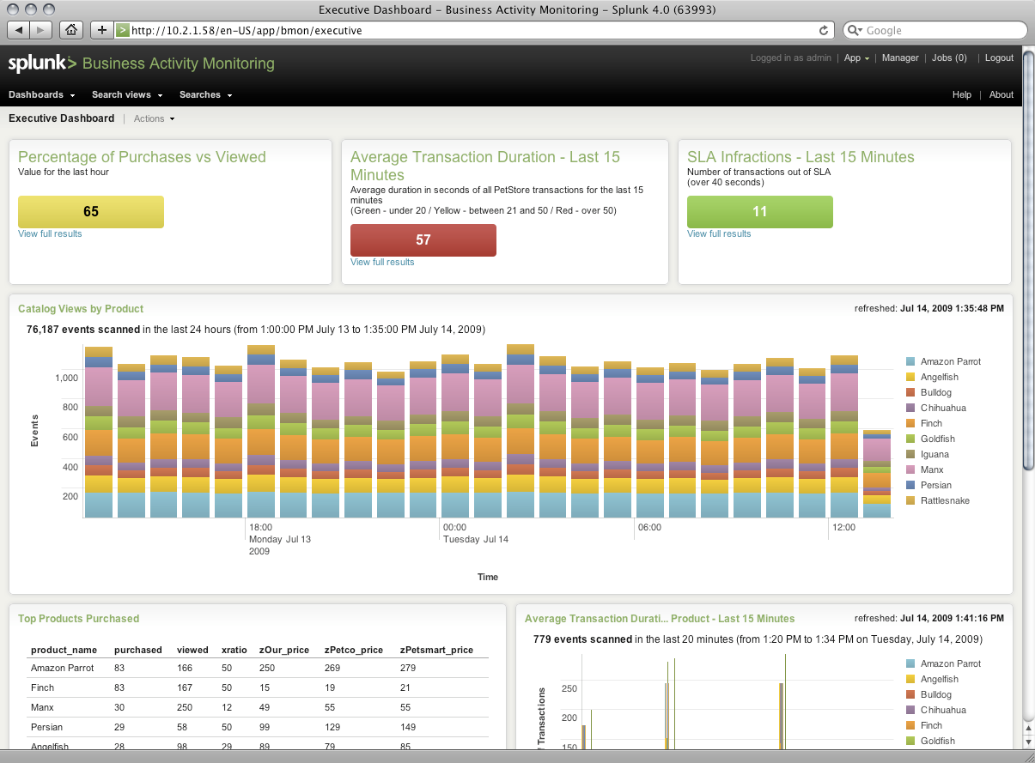
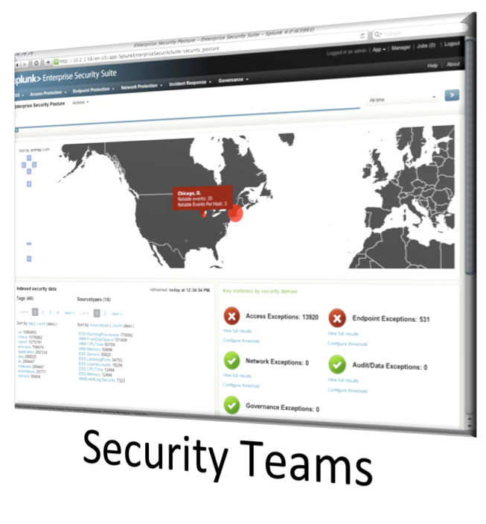
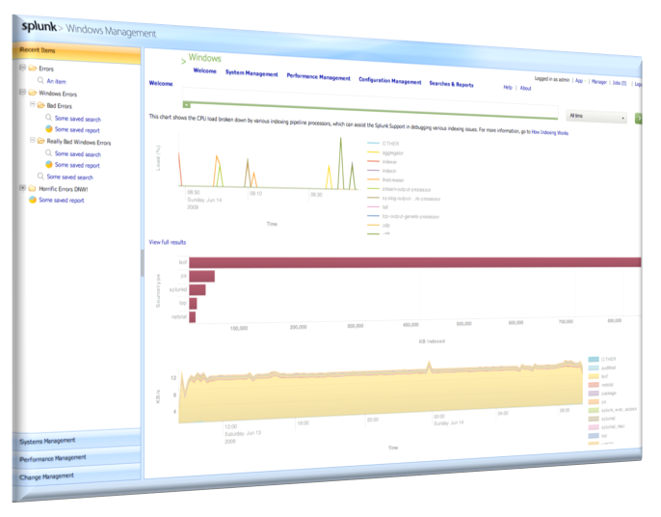
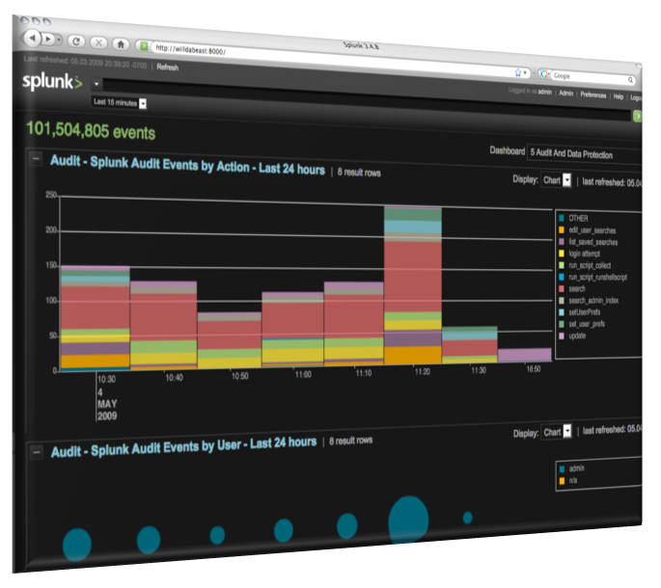
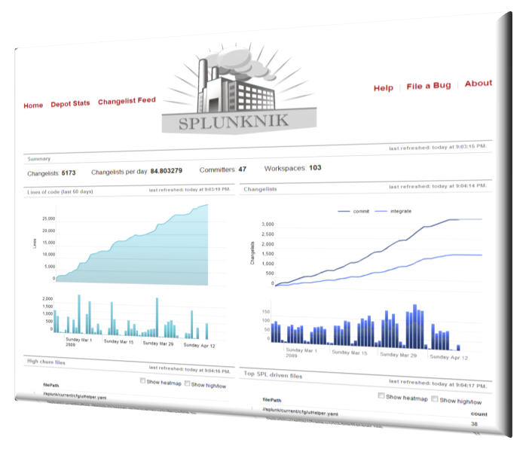
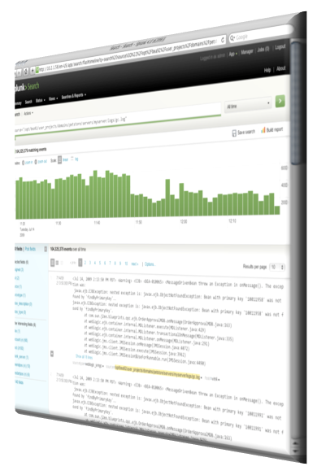
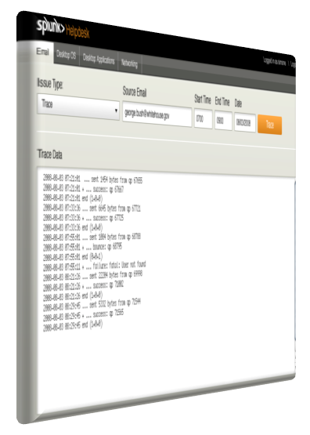

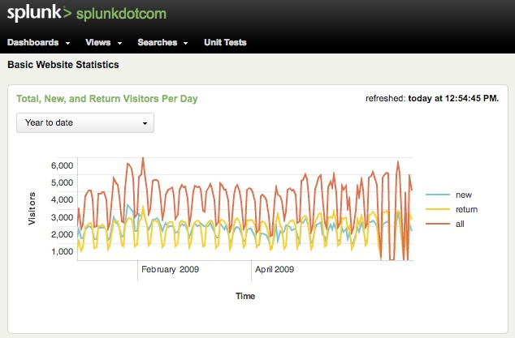
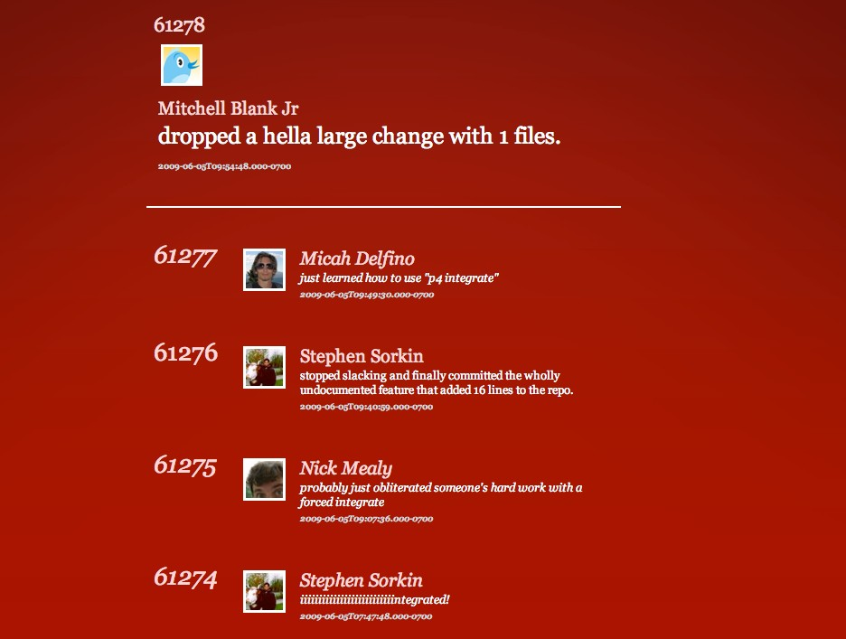



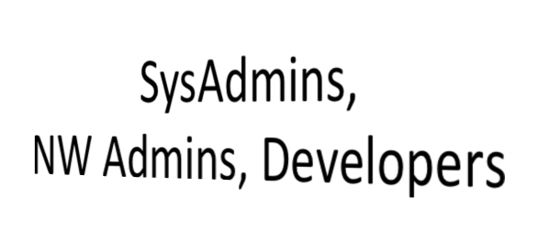
Report to any level
Support Multiple Use Cases
IT, Line of Business or Management
VPs of Infrastructure
Website Managers
Mash up Web Apps
19

Slide 20




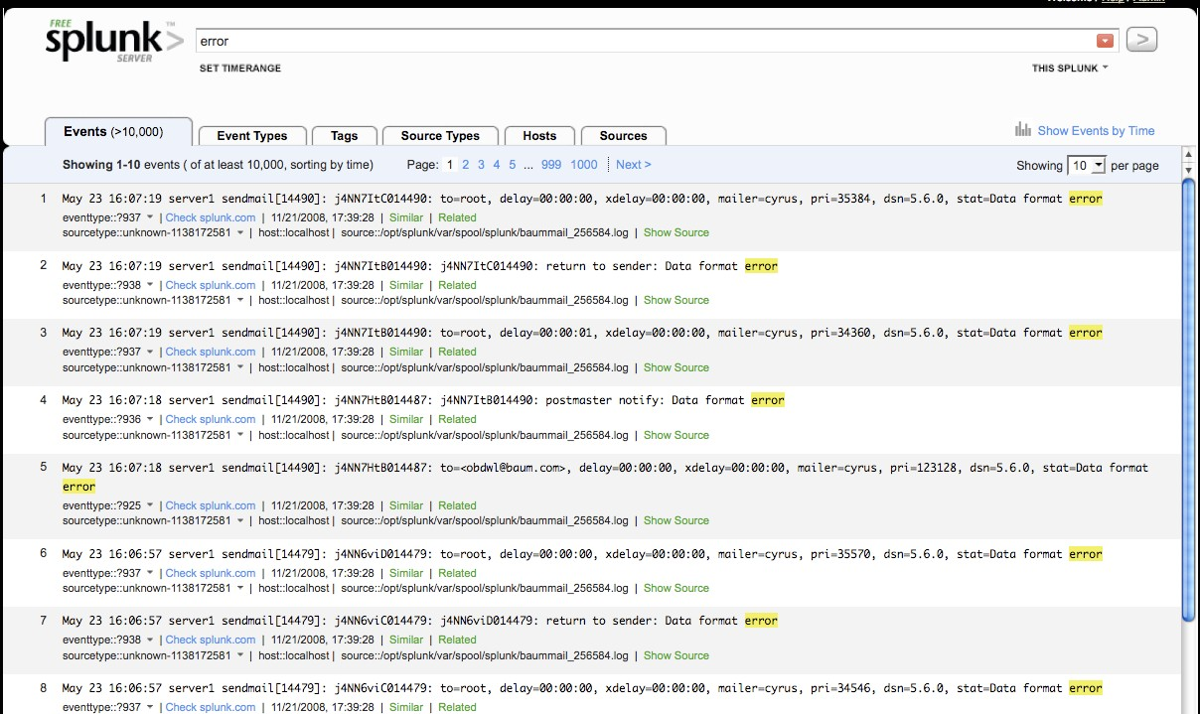
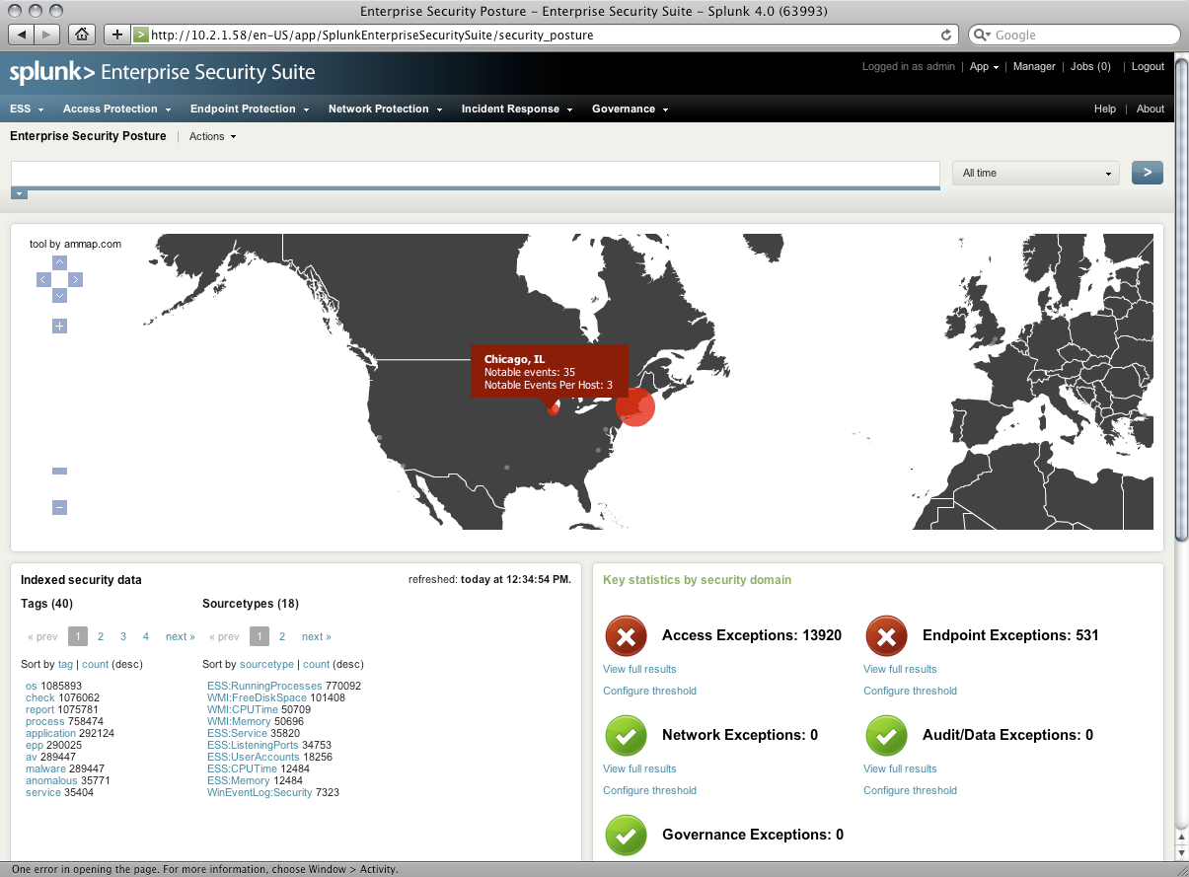
Delivering Operational Intelligence
Three Primary Capabilities
Search/Navigate
Data drilldown
“Needle in a haystack”
Root cause analysis/ troubleshooting
Incident investigations
Real-­‐time Visibility
Live dashboards
Event correlation
Monitoring and alerting
Performance issues
Transaction levels
SLA tracking
Historical Analytics
Baseline and thresholds
Trending
Operational insights
Historical patterns
Compliance reports
20

Slide 21
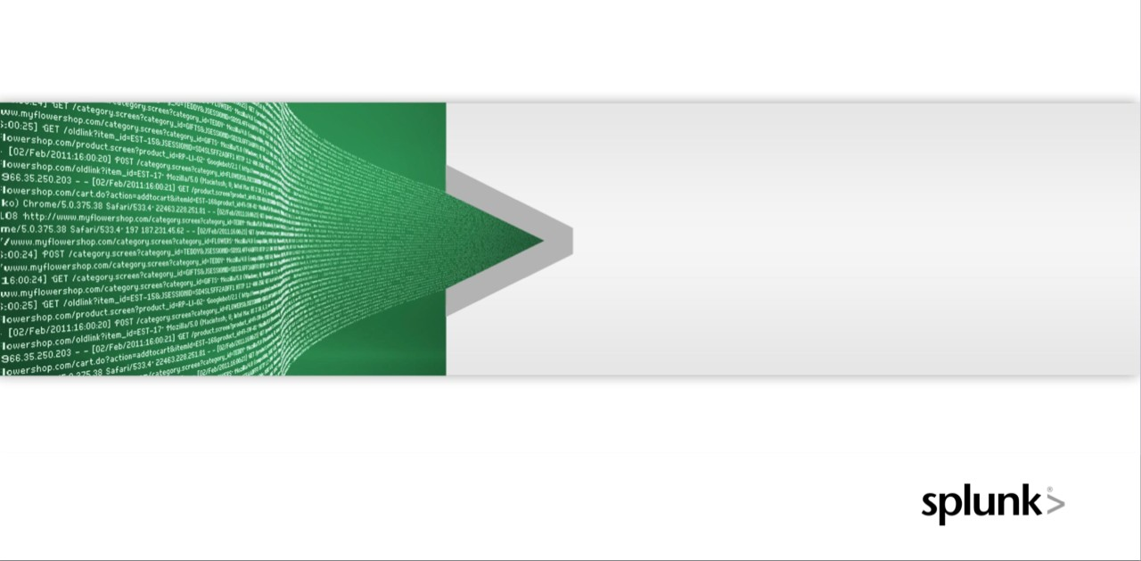

Why Splunk scales
“
“
Splunk has been tackling [big data] with a unique solution that is generating a
signiﬁcant amount of commercial success
David Menninger
VP & Research Director
21

Slide 22

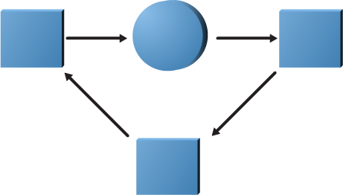
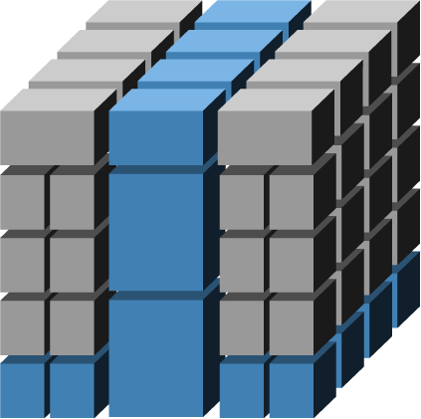

Databases are not suited for unstructured data
Relational Databases
Financial records, manufacturing and logistical information, personnel data
Data highly structured — database highly structured
Inﬂexible schema, long deployment cycle
Multidimensional Databases
Multidimensional data for business management and statistics
Math computation strength – dense data
Pivots data for ﬂexible financial analysis
Monthly reporting, not for real-­‐time events
Machine Data Engine
Time series unstructured data, with no predefined schema Generated by all IT systems, non-­‐standard data, unpredictable formats
Massive volume; fast navigation and correlation paramount
22
Visibility when you need IT most.

Slide 23






































Distributed Search using Map Reduce
MapReduce is a software framework introduced by Google in 2004 to support distributed computing on large data sets on clusters of computers. -­‐ Wikipedia
1_{⁄n}
1_{⁄n}
1_{⁄n}
A ‘search’ (question to be answered) is distributed amongst multiple cores.
Each Indexer processes a subset of the entire dataset and produces part of the overall answer back to the search head for “reduce”
Data is load balanced into commodity computers (indexers) where it is ‘mapped’.

